Slide 1
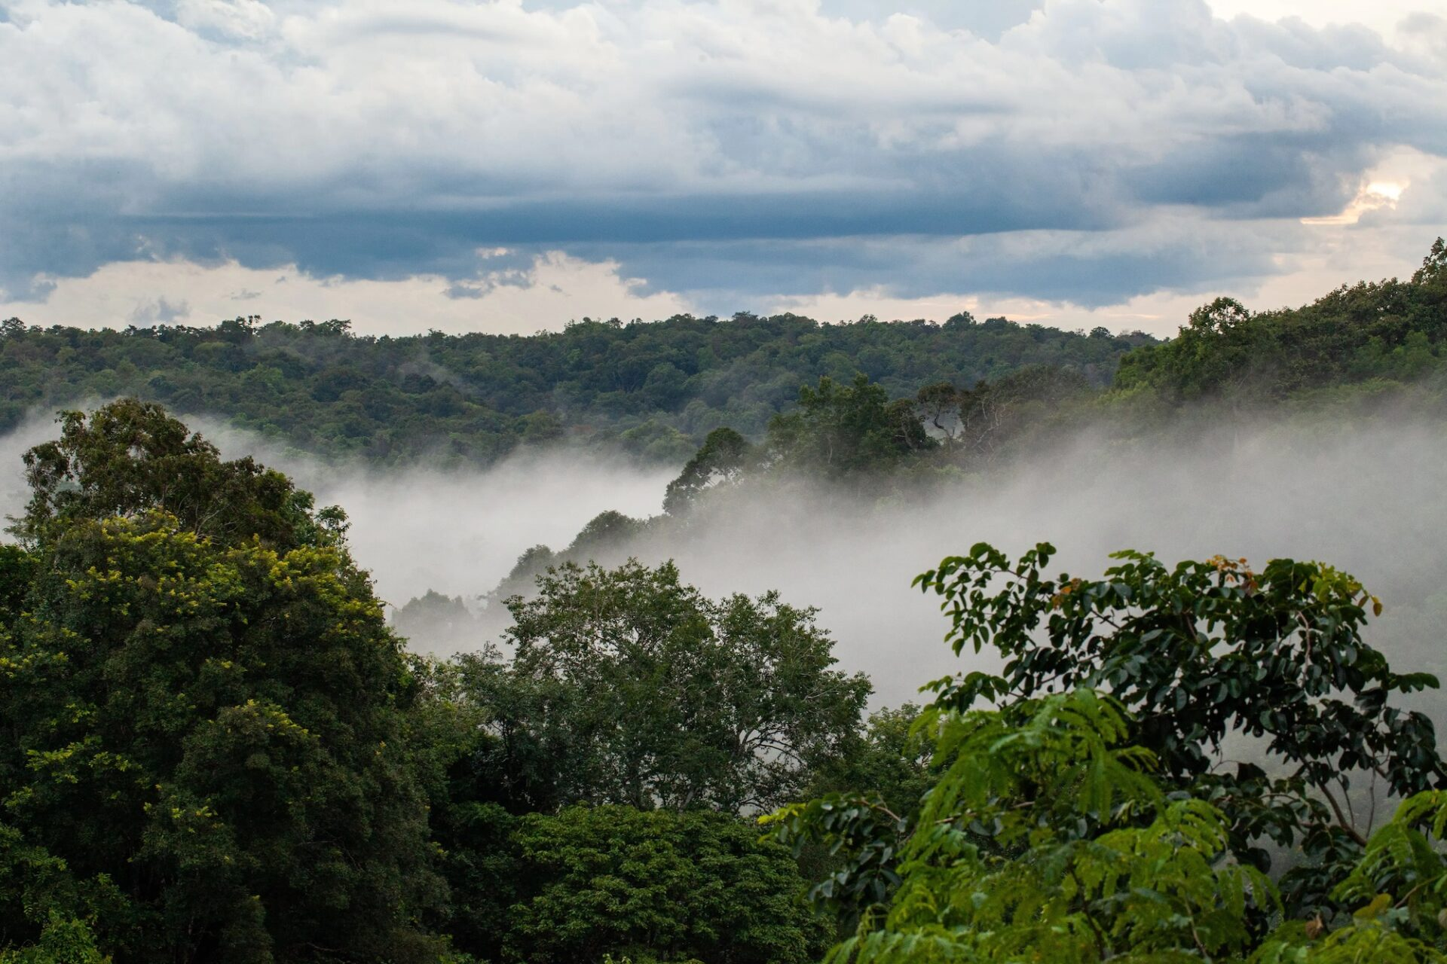
CAMBODIA’S FOREST
IN 2010

Slide 2
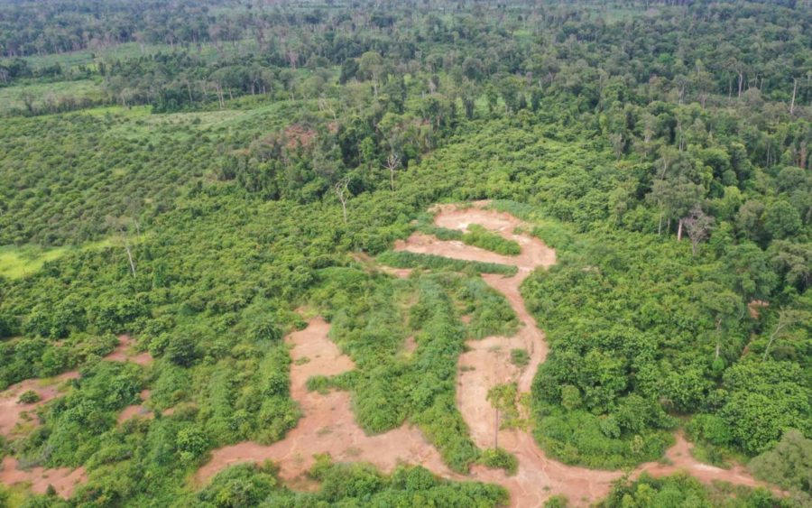
CAMBODIA’S FOREST
IN 2021

